Slide 1
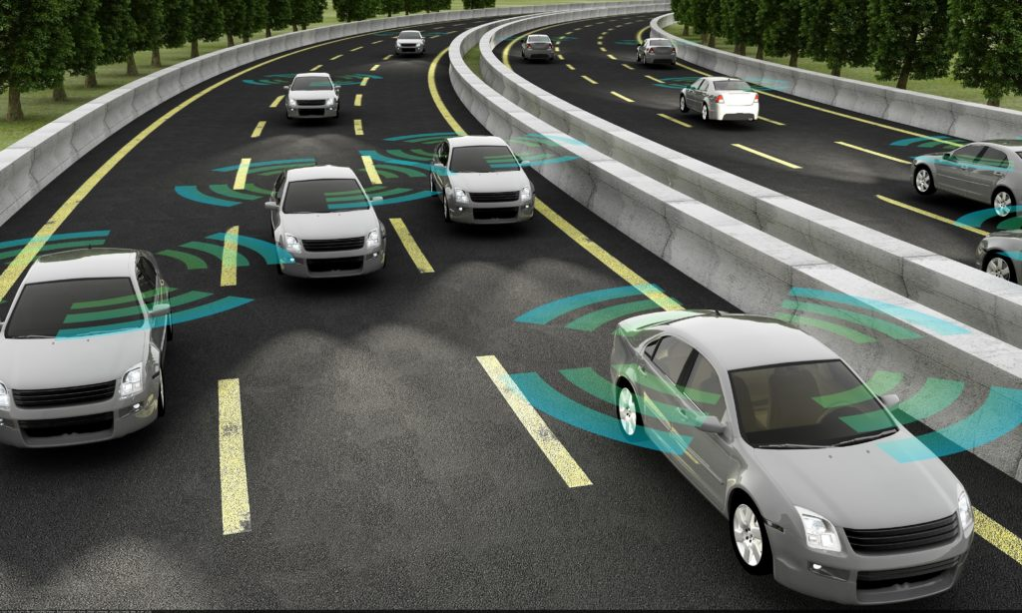
Automated Lane System
MGT1022 Lean Start-up Management
J – Component
Team Members
Ninad Rajesh Topale- 19BCE1248
Sahil Sachin Donde- 19BCE1353
Sangramjit Hazarika- 19BCE1371

Slide 2
Introduction
Construction productivity on large projects, including road construction, has been constant or declining since the 1970s. This has been coupled with a dramatic increase in construction labor cost and shortage in funding for new road construction and maintenance.
At the same time, highway construction costs have been increasing , due to such problems the world is moving to the automation . So we have taken this as our startup project “Automated Lane System”.
In 21st centaury lots of construction products are going on like BOT,TOT,HAM; so our plan is to collaborate with those projects and construct the automated roads.

Slide 3
Abstract
In this 21st century where many new modern technologies are being incorporated to all the obsolete systems, this automated lane system can become a fundamental building block for most of the engineers including us. This system will include all the basic amenities along with some additional features.
As the competition in the construction market is fiercely increasing, profit margin of construction enterprises is getting smaller and smaller, and cost control of construction projects is one of the issues to be focussed on. As a whole Construction project management is a systematic, comprehensive, dynamic subject, requiring the project manager to regularize and standardize the organization, goal, quality, safety, and cost of construction project.
With respect to our project, one must have knowledge of both technical and non-technical fields integrating with the business ideas.

Slide 4
REVIEW -1

Slide 5
Problem
Since each and everything is getting modernized we as the future engineers must try to induce technology into the road construction site too.
This system could eliminate the car accidents which are occurring at a frequent rate.
This problem arises due to poor road constructions.
As the cause is getting intensified, road blockage and traffic jams are some of the common consequences.
So there must be some way which could solve this issue!!!!
But exactly how?

Slide 6
Solutions
Third eye for the blind:- This solution will help the visually impaired person to detect obstacles in the way. This feature will notify the user depending upon the distance between user and obstacle.
Automated street lights:- We will try to build street lights which will get automatically turned on at the night time or specifically in the cloudy weather and automatically turned off in the day time .
Automated parking lot:- A unique automated parking system which will automatically allot places for the cars based on the availability.

Slide 7
Solution
Distancing between the cars :- At a particular point of road we will add ultrasonic distance sensors to calculate the distance between cars .
Smoke detection:- Pollution controlling solution using the smoke detector. The sensors will sense the level of the emitted gas and alert that vehicle
Smart tool gates:- It is a time saver and no manual work, so accurate. Best solution for the traffic jams at the toll gates.

Slide 8
Operational plan
Business model usually refers to a company's plan for making a profit.
Some of the ways through which we can improve profit margins on our project are by improving the productivity rates, understanding and analysing the costs associated, setting up profitable goals and analysing the same, factors affecting our investment, and finally analysing the results.
In order to improve productivity, we will try to plan carefully before taking each and every step keeping in mind the adverse effects it will have on our project and business.

Slide 9
Operational plan
Firstly, we need to expand our reach through the social media by creating a user-friendly website. In addition to this, YouTube can also be also be used as a medium.
Then we must contact the big dealers in order to collect a handsome capital.
The big dealers can also help us with their reach to expand our business.
After this, we must collect a group of engineers specialized in different fields including Computer Science, Electrical, Civil, Mechanical, Electronics, etc.

Slide 10
Operational plan
We must also list out the necessary electrical and mechanical components required.
We also need to invest on the ITI workers.
Coming to the funds part, we must carry out a reasonable strategy to decrease management costs and increase profit margin.
Initially we need to take a loan from the bank to begin it with our project which we will try to repay it with time.
We can also get connected to any of the venture capitalists who is basically a private equity investor that provides capital to start-up ventures.
We must also try to get a government tender which will help us gather to funds.

Slide 11
Operational plan
So we must consider all the factors in order to construct a realistic and reliable business model.
The business model must clearly specify the sources of funds to be gathered.
So we would try to follow this business model in order to carry on a hassle free business.
In addition to all these we must gather all the technical knowledge as we are ultimately seeking to build an automated lane system.

Slide 12
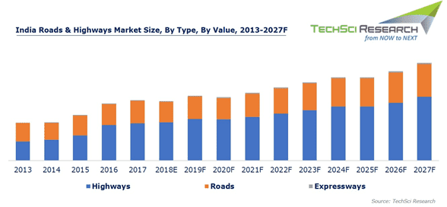
Market Analysis
India roads & highways market is projected to reach $ 24.12 billion by 2027, on account of increasing number of government initiatives such as Bharatmala, SARDP-NE, etc., aimed at developing, expanding and upgrading roads, highways and expressways in the country.
Moreover, rising population, investment enabling policy measures such as Hybrid Annuity Model, and Smart Cities Mission and on of the important point is automation in road system are some of the other factors that are expected to positively influence the country’s roads & highways market over the coming years.

Slide 13
From the graph we can analyse that the previous projects and also the future projects are focusing on the highways , so we are keeping our primary target as highways – smoke detection, toll gates etc we can apply
We can’t under estimate the normal roads ;so secondary focus on such roads which include the modules like- third eye for blind, traffic lights etc

Slide 14
Major Companies in road construction
Some of the major companies operating in the India roads & highways market include:-
NHAI
Simplex Infrastructure Limited
IRB Infrastructure Developers Ltd.
GMR Infrastructure Limited
NCC Limited, Dilip Buildcon
Hindustan Construction Company Ltd
Sadbhav Engineering Limited
Reliance Infrastructure Limited
MEP Infrastructure Developers Limited
L&T Infrastructure Development Projects Limited
NHIDCL etc.

Slide 15
Quantitative Market Analysis
To analyze and forecast India roads & highways market:-
Multiple employees from several companies have been interviewed through telephonic conversations to extract and verify the information being collected at the source.
A brief study of the major players operating in India roads & highways market was conducted, which included analysis of information such as ongoing projects, details of expected year of project commissioning and estimated investments along with the expansion plans of various projects in the country.
The above sources are primary sources for the market analysis

Slide 16
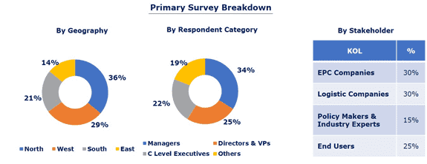
Various secondary sources such as white papers and secondary literature on Basic Road Statistics, Ministry of Road Transport & Highways, National Highways Authority of India, National Urban Transport Policy, World Bank, Company Websites & Annual Reports, etc.

Slide 17
Key Target Audience
Road Construction and EPC Companies
Financial Institutions such as NBFCs & Banks
Foreign Investors
Government bodies such as regulating authorities and policy makers
Associations, organizations, forums and alliances related to roads & highways sector
Market research and consulting firms

Slide 18
REVIEW -2

Slide 19
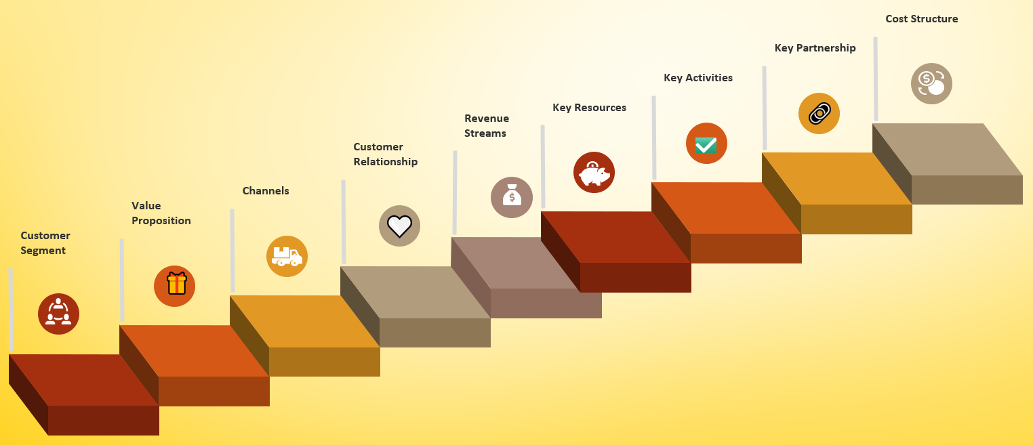
BUSINESS MODEL CANVAS
Building Blocks

Slide 20
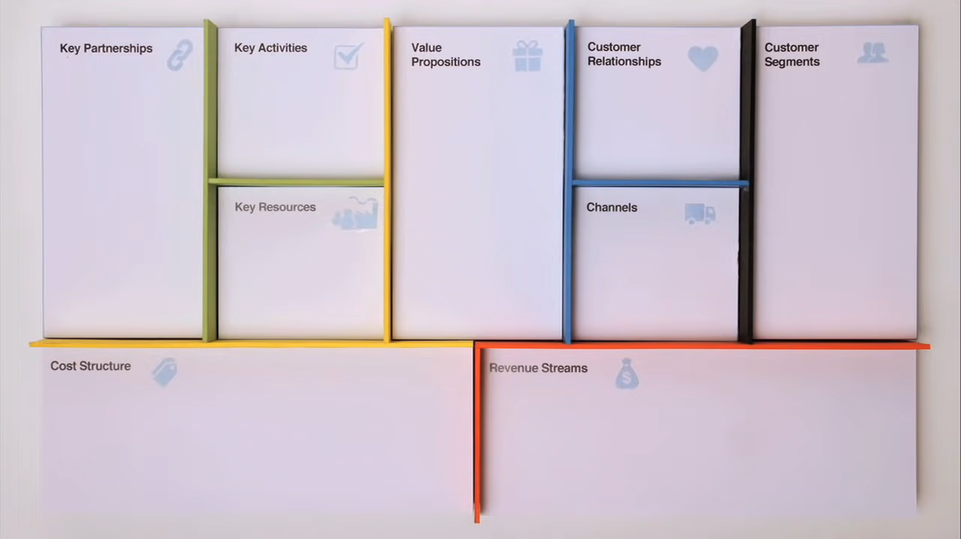
Helps to design discuss and invent new models:-

Slide 21
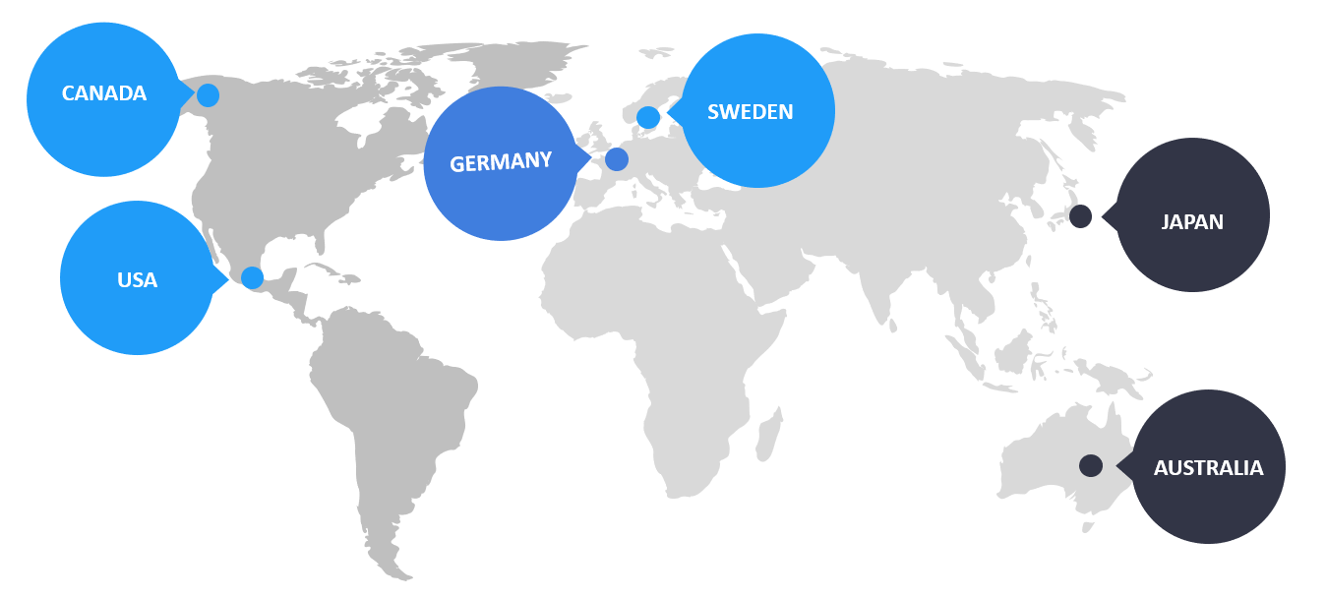
CUSTOMER SEGMENT
These are all the people or organization for which we will provide the value, this includes simple customers
We planned to focus on ongoing projects of automated lane system in the different countries .
We will focus on the such ongoing projects and try to implement our idea
Current Automated Projects

Slide 22
COMMENCED | COUNTRY | PROJECT | DESCRIPTION
2023 | GERMANY | C-ITS Corridor | This multi-project R&D environment on a Rotterdam – Frankfurt – Vienna motorway corridor will result in the 'gradual deployment of Cooperative Systems, allowing the exchange of traffic-related information among vehicles and between vehicles and the roadside infrastructure.'
2021 | SWEDEN | Gothenburg autonomous shuttle trial | A 4.5 month trial of two Navya autonomous shuttles, running on a on a fixed 1.8 km route serving the Lindholm Industrial and Science Park.
2021 | USA | I-70 Connected Roadway | Project partners the Colorado Department of Transportation and Panasonic have installed roadside units along the I-70 Mountain Corridor to provide real-time information to drivers and traffic managers about V2X-equipped vehicles.
2020 | AUSTRALIA | Driverless Shuttle Trial: Newcastle NSW | A 3-month trial of a driverless shuttle, running in the NSW Mid-North coast city of Newcastle, daily between 10am and 2pm.
2019 | CANADA | Colibri | A 1-year pilot project in Quebec of electric cargo bikes and other zero-emission vehicles, with the aim of reductions in congestion and pollution impacts of last-mile deliveries.
2018 | JAPAN | Car Sharing Service Trial in Central Tokyo | A trial operation between Toyota and Park24, with the aim of developing a new service that leverages Toyota's Mobility Services Platform (MSPF). Sixty Toyota C-HRs have been designated as the vehicles for use, and the trial is scheduled for a 10-month period from June 2018 to the end of March 2019.

Slide 23



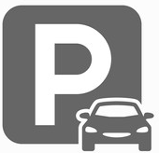
VALUE PROPOSITION
The Value Proposition Canvas is a tool which can help ensure that a product or service is positioned around what the customer values and needs.
Smart Toll Gates
Car Distancing
User need to save time and have a quick travelling.
Customer need technology to avoid car accident
💥
Third eye for Blind
Automated Street Light
Visually impaired person need this feature.
🚦
Energy saving technology for the government
Smoke Detection
Automated Parking Lot
Pollution control need for environment
Mall and theaters need of automated toll gates and also on the highways .

Slide 24
CHANNELS
Which touch point we are interacting with customers and delivering values
TYPES OF CHANNEL PHASES :-
how do we help customers evaluate our organization’s Value Prop?
how do we deliver a Value Proposition to customers?.
EVALUATION
DELIVERY
AWARENESS
PURCHASE
AFTER SALES
how do we raise awareness about our company’s products and services ?.
how do we allow customers to purchase specific products and services?
how do we provide post-purchase customer support?

Slide 25
CUSTOMER RELATIONSHIP
How to Grow Customer Relationships
Customer relationships describes the type of relationship a company establishes with it’s specific customer segments. Customer relationships are driven by customer acquisition, customer retention, and boosting sales – in other words you need to get, keep, and grow your customer relationships.
01
02
03
04
05
Engage and delight your customers..
Keep the conversation going.
Listen to customers.
Stay available across all communication channels.
Make the best use of your tools.

Slide 26
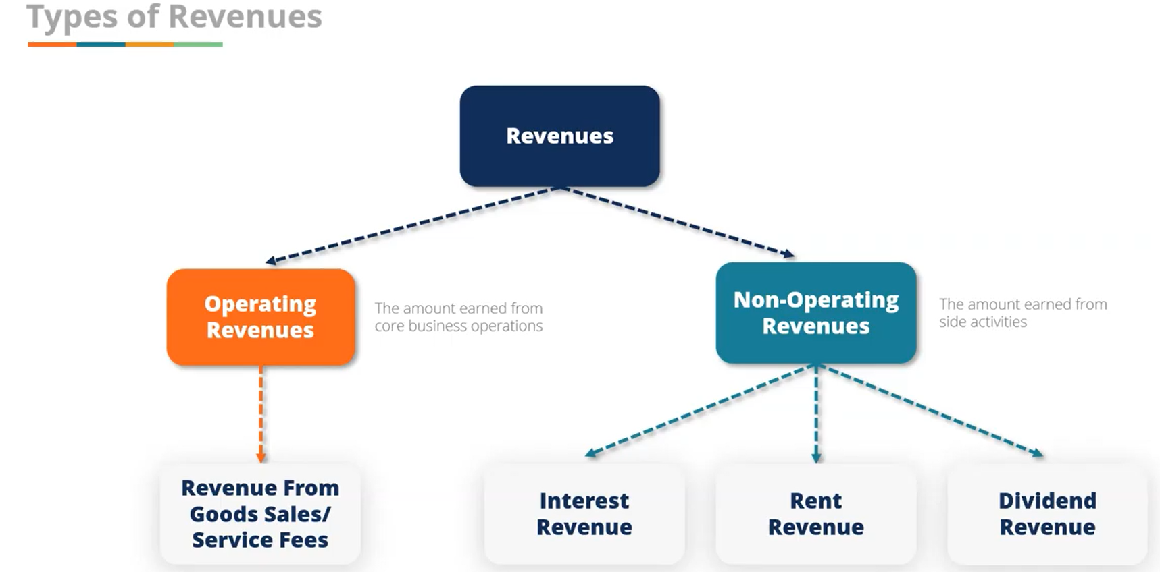
REVENUE STREAMS
Various resources from which a business earns money from the sale of goods or provision of services

Slide 27
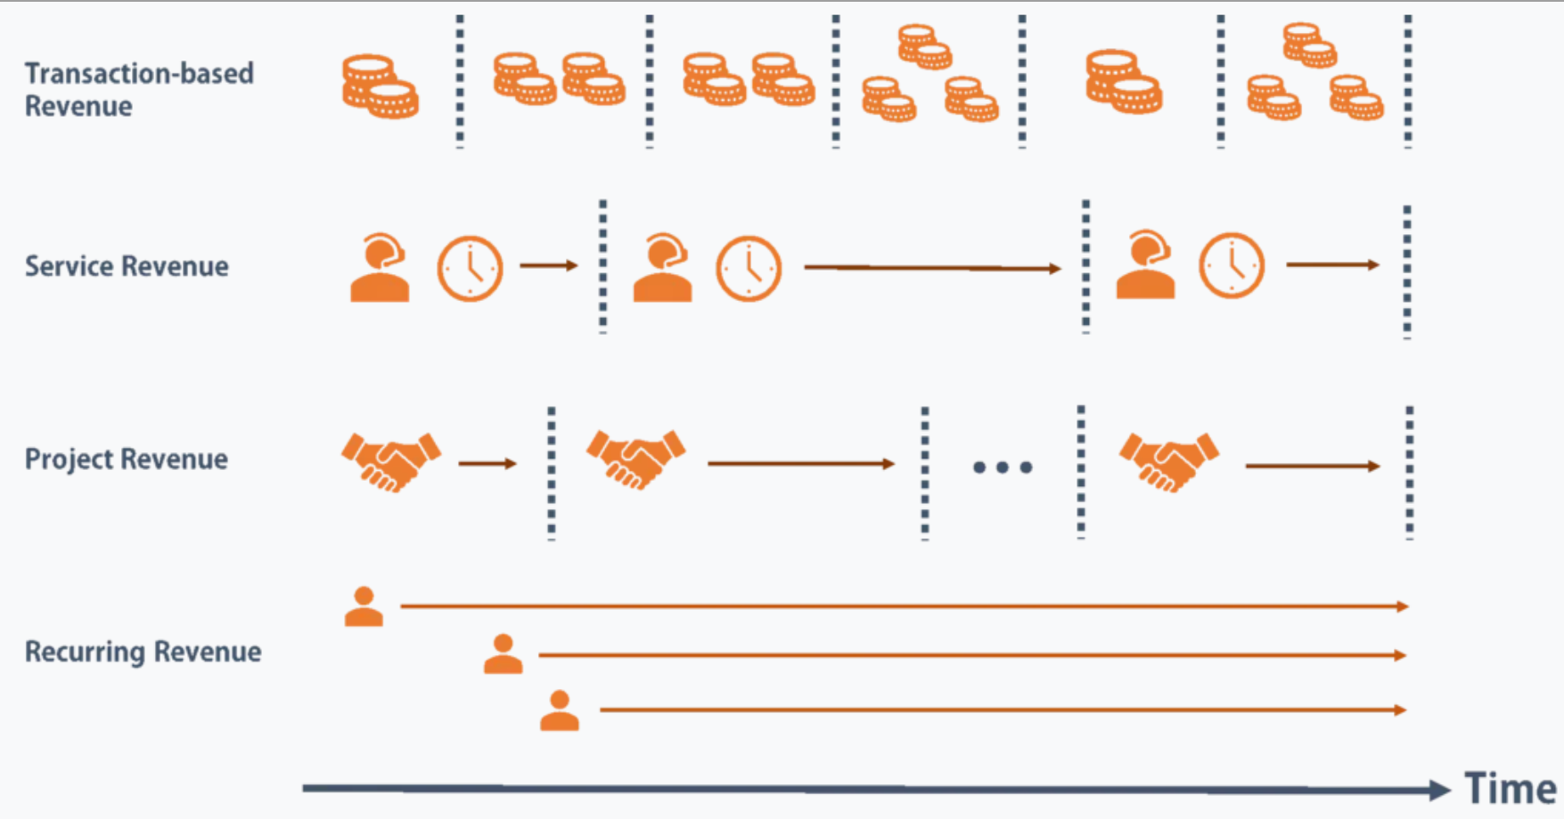
Examples of Revenue Streams

Slide 28
Key Resources
Key Resources describes the most important assets required to make a business model work.
PHYSICAL RESOURCES
Buildings, vehicles, machines, raw goods, etc.
HUMAN RESOURCES
Creativity, experience, etc.
FINANCIAL RESOURCES
Cash, credit, stock, etc.
INTELLECTUAL RESOURCES
Brand, proprietary knowledge, patents, partnerships, etc.

Slide 29
KEY ACTIVITIES
The Key Activities Building Block describes the most important things a company must do to make its business model work
Production
Problem solving
Platform/network

Slide 30
Key Partners – we are looking for
Key Partners are the relationships that you have with other business, governmental, or
non-consumer entities that help your business model work
Strategic alliances between non-competitors
This means that you and a company that you have no direct competition with, industry wise, will partner together in ways that will benefit the both of you.
Coopetition
This is the strategic partnership between competitors. This one is a little wacky; it means that companies who may be directly competing will still work together to generate awareness for their shared industry, in the attempt to gain new users for all those in the industry to compete for.
Joint Ventures to develop new businesses
Here you may join your company with another to create an entirely different entity, which may be more profitable for the both of you than if you were to operate separately. Example: Blu-ray is an optical disc format jointly developed by a group of the world’s leading consumer electronics, personal computer, and media manufacturers..
Buyer-supplier relationships
Specifically, building reliable relationships with a buyer or supplier. You need to incorporate the characteristics of trust, quality, and commitment between the two entities.

Slide 31
Cost Structure
Cost Structure defines all the costs and expenses that your company will incur while operating your business model.
This final step in the process is important, because it will help your team decide whether to pivot or proceed.
value-driven cost structures
create more value in the product itself, not necessarily producing the product at the lowest possible cost.
cost-driven cost structures
focus on minimizing the costs of the product or service as much as possible

Slide 32
REVIEW -3

Slide 33
Customer Acquisition
Businesses spend much on acquiring a client without calculating the COCA
Understand long-term relational value and hold your customers
COCA - average cost of convincing a potential customer to use a product or service
Marketing + Advertisement + Sales → 1 crore
More COCA good if recurring business model else keep it low
100 new customers
COCA = 1 crore / 100 customers = 1 lakh

Slide 34
B2B2C Model
We make partnership with companies with a larger consumer market
Made partnerships with road brokers and agents – have a larger consumer market.
A business not having direct access to consumers, will gain it via a other business
Other business allows first business to gain access to its consumers
Automated Lanes - We don’t have many customers
Make brand recognized to the consumers
Over the time the first market gets a larger consumer market

Slide 35
Make Customer from Customer
Current customers tend to try our new products
Existing customers are 50% more likely to try new products
They spend 31% more, on average, when compared to new customers.
The probability of selling to a new prospect is just 5-20%.
Our regular customer will be willing to truly listen to what we have to offer.
The probability of selling to an existing customer is 60 – 70%,

Slide 36
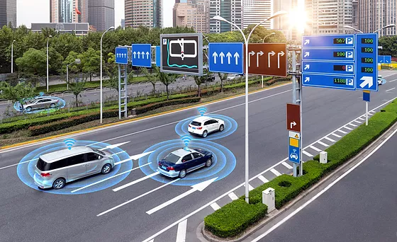
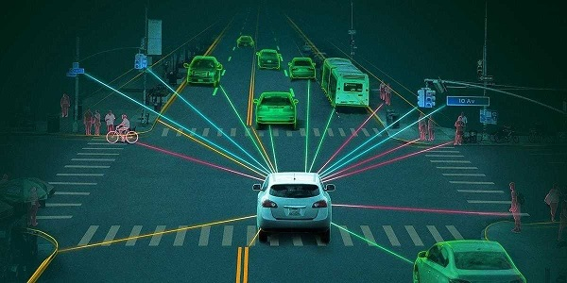
Funding Plan
Capital is what gets our foot in the door. It lets invest in other essentials and carry on with our work. Indeed initially we have to spend a huge amount to begin with but we could adjust it if we manage our funds in a proper manner.

Slide 37
Funding Plan
Firstly, we could take a loan for starting up the business and then try to repay it within the specified period of time.
Many companies have accelerated their IT spending, especially for AI technology,
to keep their business going. Around the globe in the year 2020 many such
companies invested in AI driven start-ups or small businesses as for example
Autonomous cybersecurity platform company SentinelOne raised US$267
million in Series F in November.
We could also submit our model to some of the famous IT companies so that if our
model is accepted, we could make use of the tech parks to deploy our project and
could also access some of the resources provided by them like their laboratories and all.
It is seen that famous tech companies like Google has also nurtured many startups in India which is indeed a good sign.

Slide 38
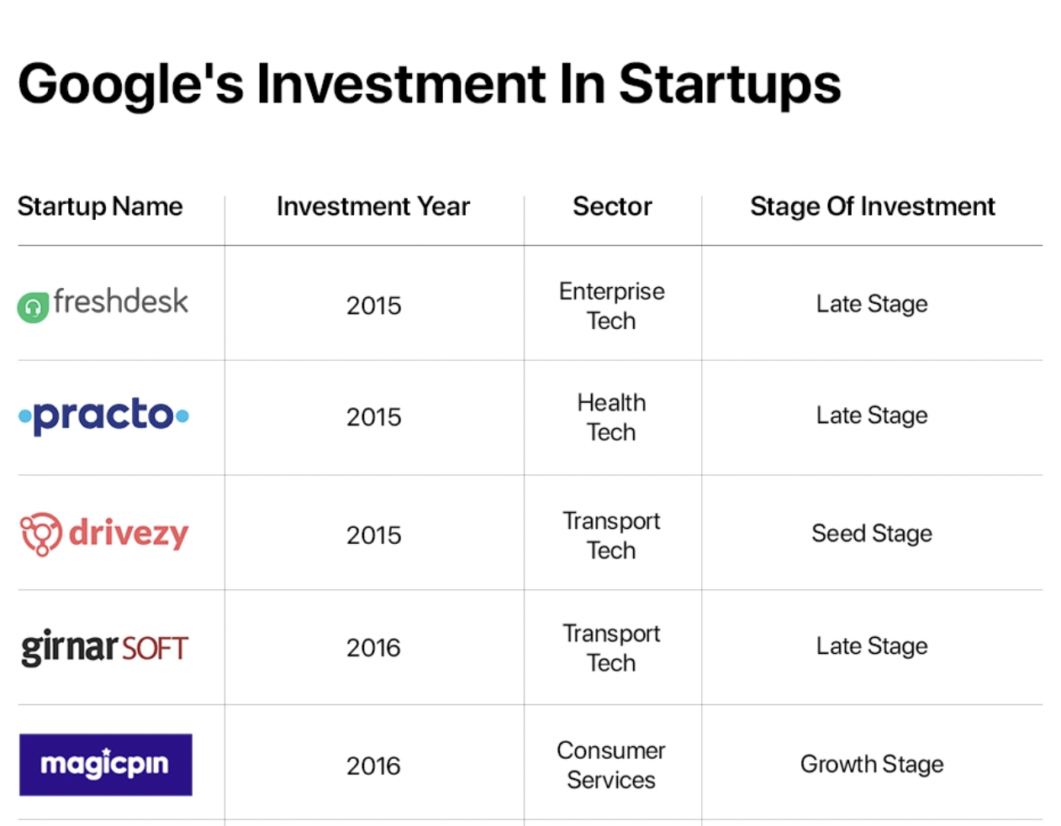

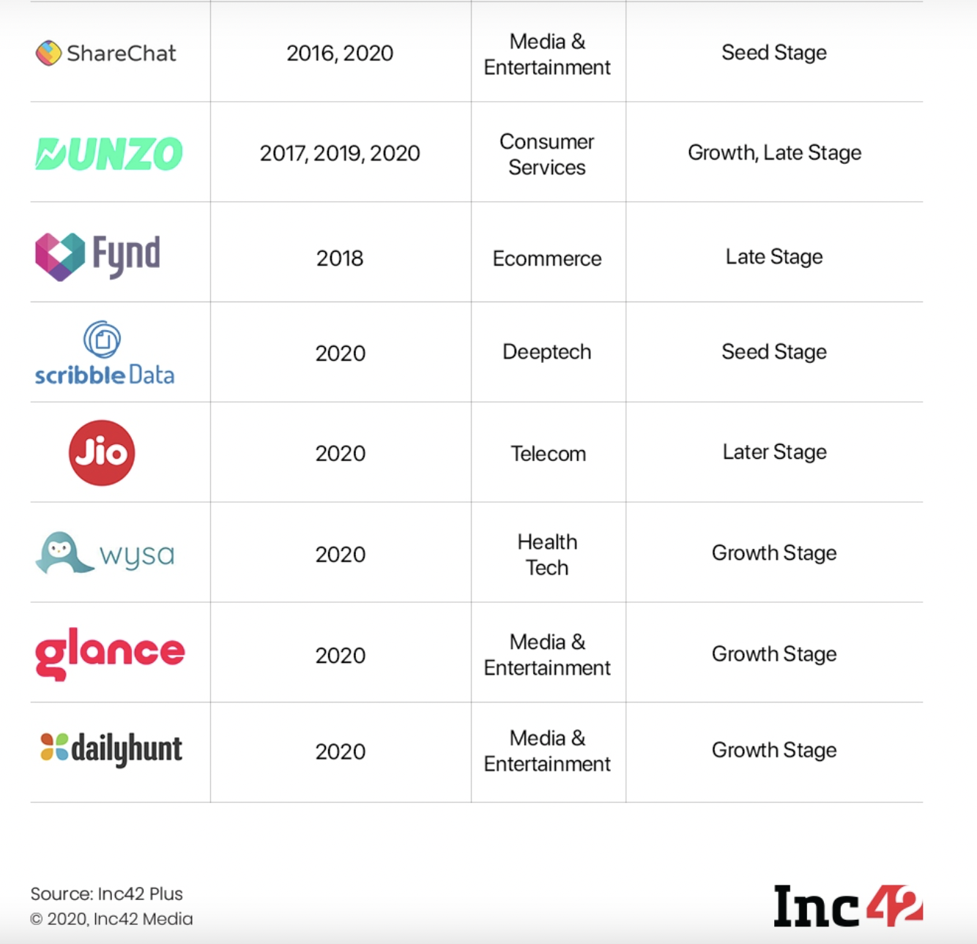
Recent Trends of Funding

Slide 39
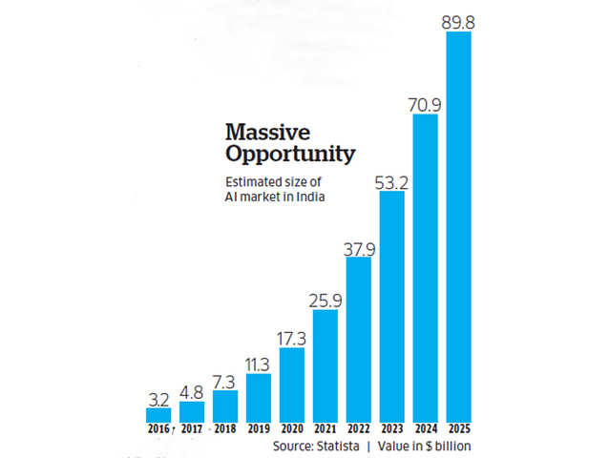

Slide 40
Funding Plan
We could join hands with a road construction company to gather some of the resources which would be needed to deploy our model.
We must get in touch with the venture capitalists who professionally managed funds
to start-ups that have success potential. The best part about venture capital
investments is the expertise and monitoring that they bring along. Ordinarily, VCs invest in equity
and once the business releases its IPO or is acquired, they then tend to leave.
Last but not the least, we can also look for individuals with surplus cash looking for investing in
promising startups and earn their share once it grows to its potential. They can either work alone
or collectively in a network to screen startups with huge potential. This funding option has business
minds looking to earn interest out of our success and they may expect as high as 30% equity as well.

Slide 41
Marketing Strategies
1. Ensure your number is easy to find everywhere
Construction is an industry where phone calls plays a vital role
Phone no. would be connected to the websites, adds on google, billboards and on flyers
2. Set up Google local service ads and doing Google listing
Google local service adds, you-tube adds
“Construction company near me” - Service ad with a “Google Guaranteed Badge” appears alongside - direct link to our phone number.
3.Bring Your Business Online
Customers spending time online - mandatory to advertise your business online.
Hiring web-developers to build a website for our company - professional website design

Slide 42
4. Niche Marketing
A small, well-defined yet profitable segment of a market to focus
Competition among construction organization is ever growing
Understand the types of customers we’re targeting, and what their needs and desires are
5. Invest Some Time on Social Media Marketing
Can give us traffic of potential customers
Write some attractive sentences that would attract the potential customers
landing page we would be showing the visitors some of the ongoing construction projects
6. SEO – Search Engine Optimization
Take help of Keyword planner tools to know what the keywords specific to our industry are

Slide 43
7. Be Very Specific While Advertising Your Services
Creating advertisements by showing limited features of our organization – Strong features
Keeping our audience engaged - increasing their chances of turning to us for our more services
8. Follow up with past customers
Encouraging our past customers to keep coming back.
Positive relationships is a great construction marketing strategy
9. Create compelling video content
Video - our projects or a time-lapse video of the construction process
Will help make our company more personable and help build our audience.

Slide 44
10. Freebie Marketing – Impart Some Services for Free
Customers attract towards any proposal to get something for free
If they like they easily spend money to keep in contact with the freebie provider.
11. Building a Brand
Website would get more credibility by customers and search engines with the brand
Building a brand name - graphic design services.
These services will help one build the brand name and do the marketing for one’s brand.
12 Cross Business - Build Relationship with Non-Competing but Related Businesses
A healthy relationship with our sub-contractors like architect, electrician, plumber, interior-designer, painter etc. can earn us loads of referrals

Slide 45
Initial Public Offering (IPO)
First time a company issues shares to the public
Some shares as Public
When SEBI (Securities and Exchange Board of India) regulations are fulfilled we would be allowed to go for IPO
Initial share holders the founders and venture capitalists
Document including financial records, future plans for the company, potential risks or the share price range would be submitted to the SEBI

Slide 46
Going for IPO – Initial Public Offering
To raise capital for growth and expansion
Our company may needs money to increase its operations, create new products or pay off existing debts.
Going public is a great way to gain this much-needed capital for a company.
Allowing owners and early investors to sell their stake to make money
Venture capitalists sell their stock in the company at this time to reap returns and exit from the company.
Greater public awareness
This is a great way for a company to publicize its products and services to a new set of customers in the market.

Slide 47
Some more Investments and the Profits generated
Purchasing all the equipment's required and giving it for rents when not in use
Investing money on the employees, workers and the hired web developers
Marketing
Giving our labour to other big construction dealers from where we would get a share of their profit
Making plans of buildings, supervising other construction sites
Initial Public Offering
Investing money on various electronic components

Slide 48
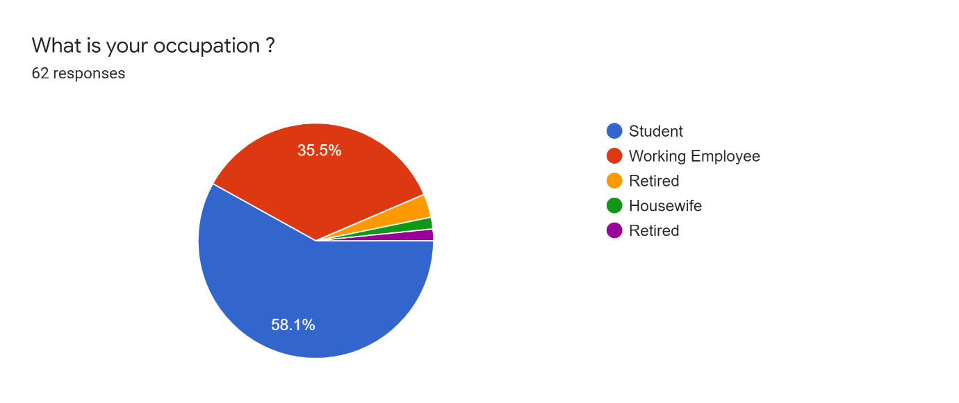
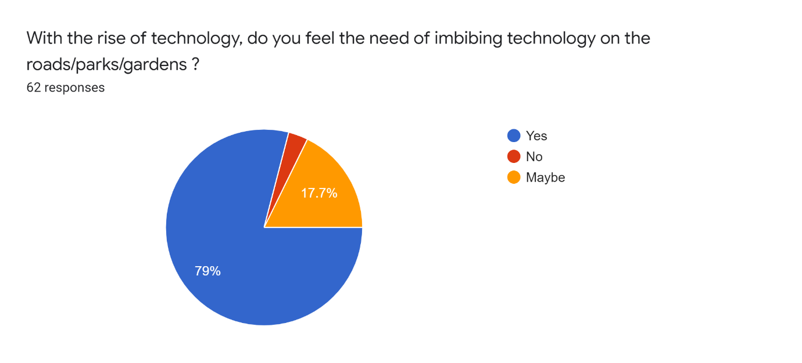
Customer feedback

Slide 49
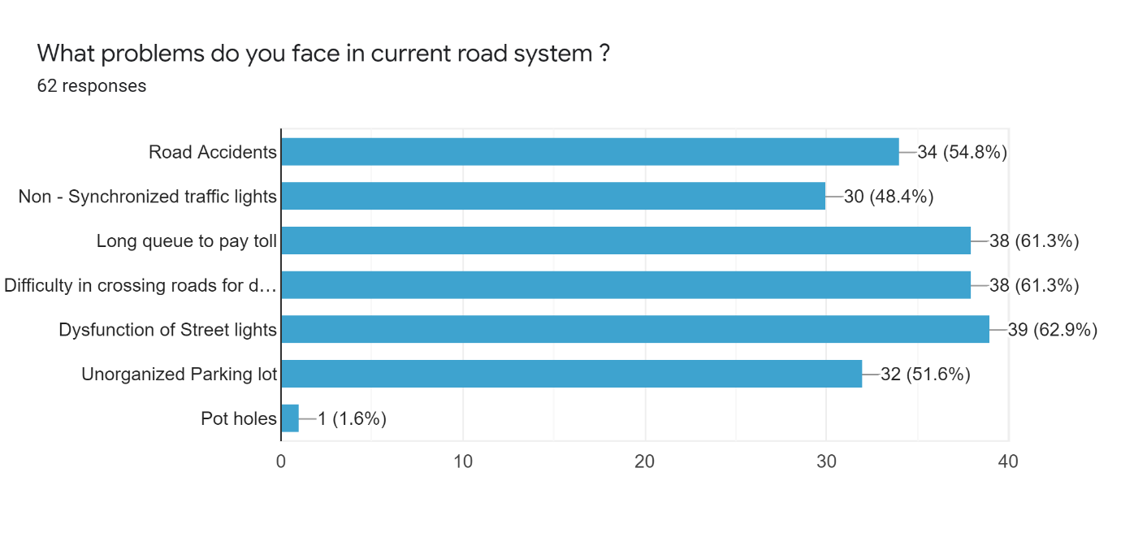
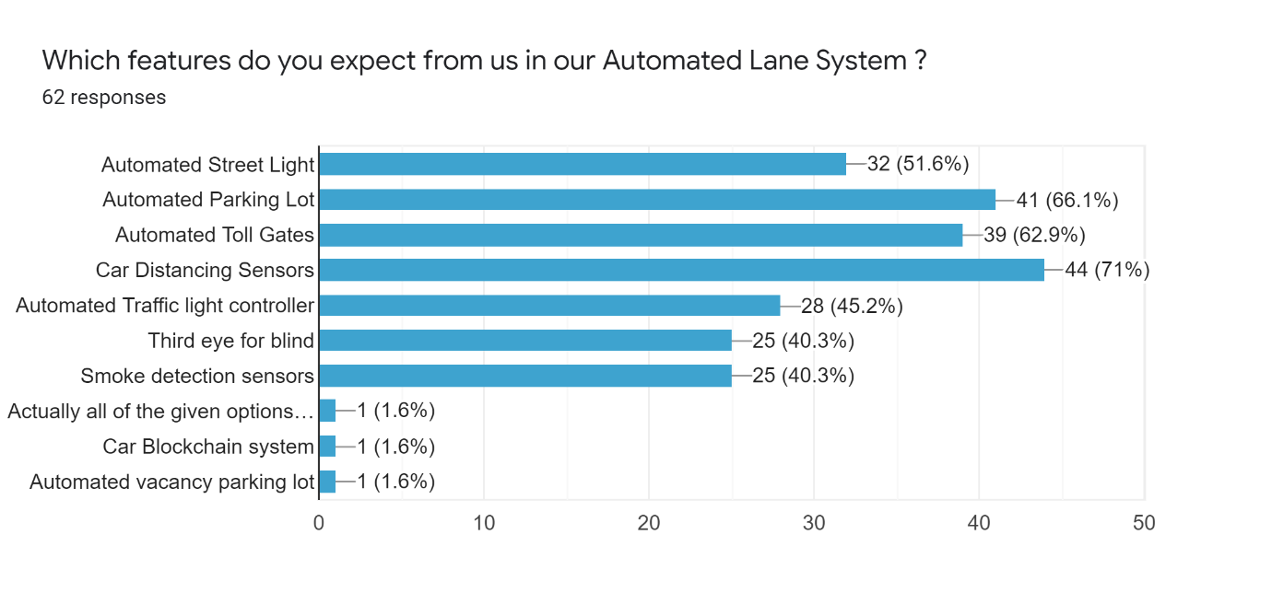

Slide 50
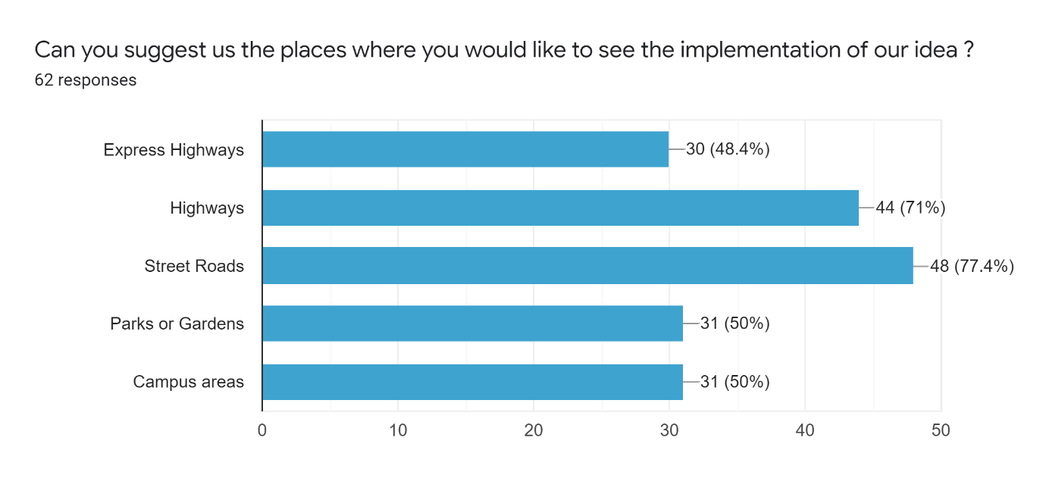
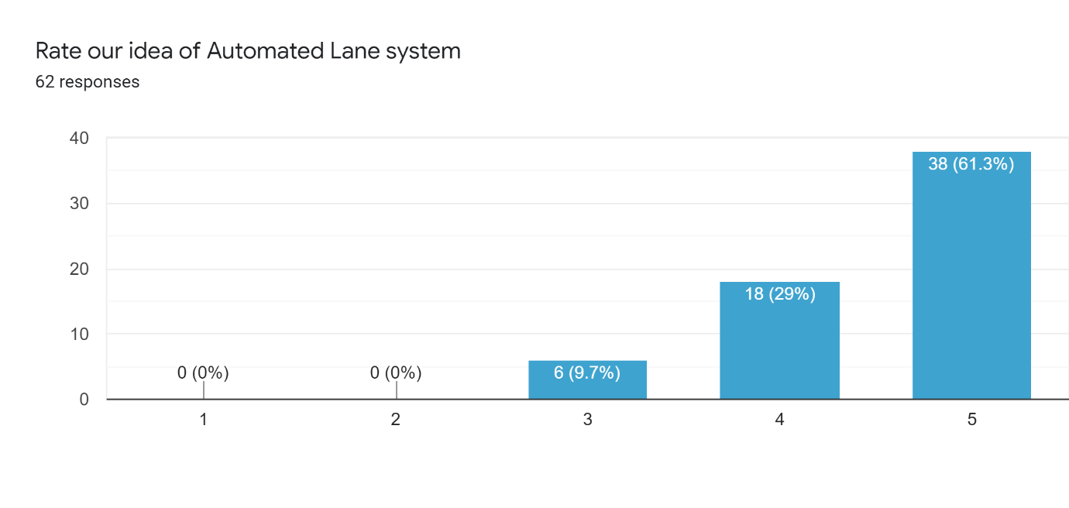

Slide 51
Valuable suggestions from some of the future users
• AI has been incorporated in each and every field. We being the future engineers can work together to bring some changes in the currently existing lane system. So this is a good step. The only thing that is needed to be kept in mind is that we must be aware of the source of fund during the initial phase as these types of automated system needed a fair amount of funds.
• Google already provides options for best route based on various conditions. Based on the cars on road and where they are heading to, it may be good to have synchronized traffic signals and diversion of routes for same destination. Also, we should have ability to book a parking lot while driving. Also, it may be good to have VIP vehicle movements synchronized with traffic situations.
• Yes this is a great idea considering the current traffic conditions. At our times in the late 1980s the situation was very nice, since automobile industry had just started to grow but now there is a need of such things to manage the roads and vehicles.

Slide 52
Thank You

